Slide 2
exploring and understanding the concepts of nosql.
learn history of nosql databases

Slide 3

Introduction to NoSQL
Non-relational Data Management System

Slide 4
Introduction to NoSQL
Avoids joins
Easy to scale

Slide 5
Introduction to NoSQL
What is the major purpose of using a NoSQL database?
The major purpose of using a NoSQL database is for distributed data stores with huge data storage needs. NoSQL is used for Big data and real-time web apps.

Slide 6

Introduction to NoSQL

Slide 7

Introduction to NoSQL

Slide 8

Introduction to NoSQL

Slide 9
Introduction to NoSQL
NoSQL database stands for
  "Not Only SQL" or "Not SQL.“
  Though a better term would be "NoREL", NoSQL caught on.
Carl Strozz introduced the NoSQL concept in 1998.

Slide 10
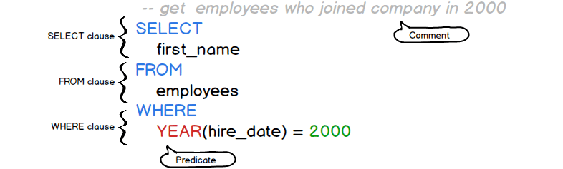
Introduction to NoSQL
Traditional RDBMS uses
SQL Syntax

Slide 11
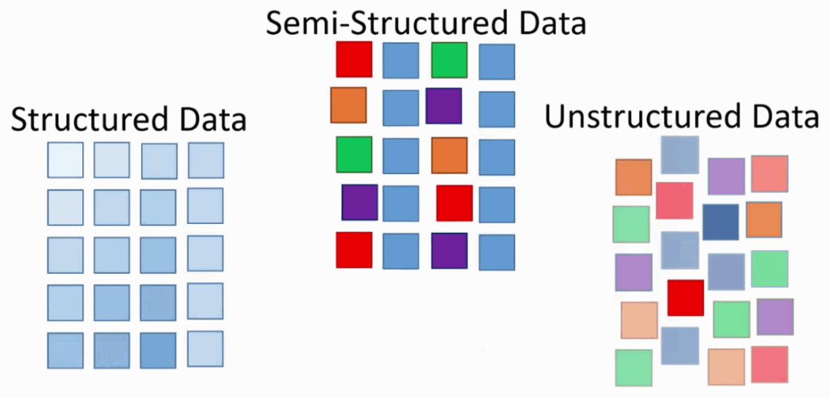
Introduction to NoSQL
Instead, a NoSQL database system covers a wide range of database technologies that can store

Slide 12
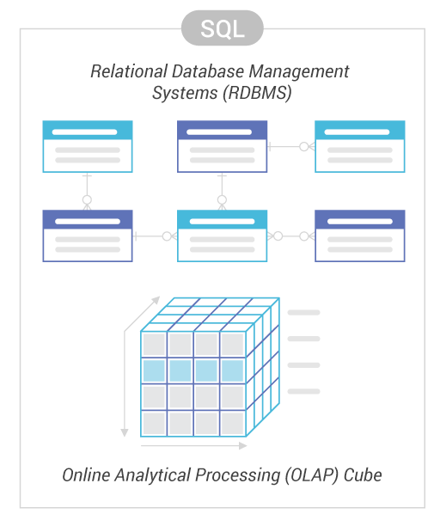
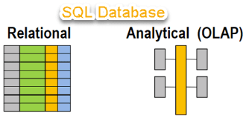
Example of SQL Database

Slide 13

Why NoSQL?

Slide 14

Why NoSQL?
Slow Response Time

Slide 15
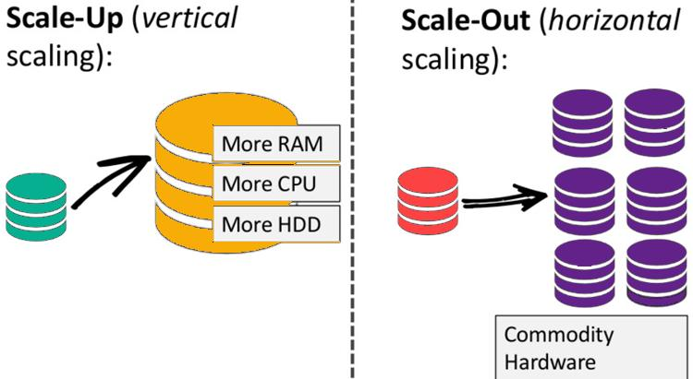
Why NoSQL?

Slide 16
Why NoSQL?

Slide 17

History of NoSQL Databases
1998- Carlo Strozzi use the term NoSQL for his lightweight, open-source relational database

Slide 18
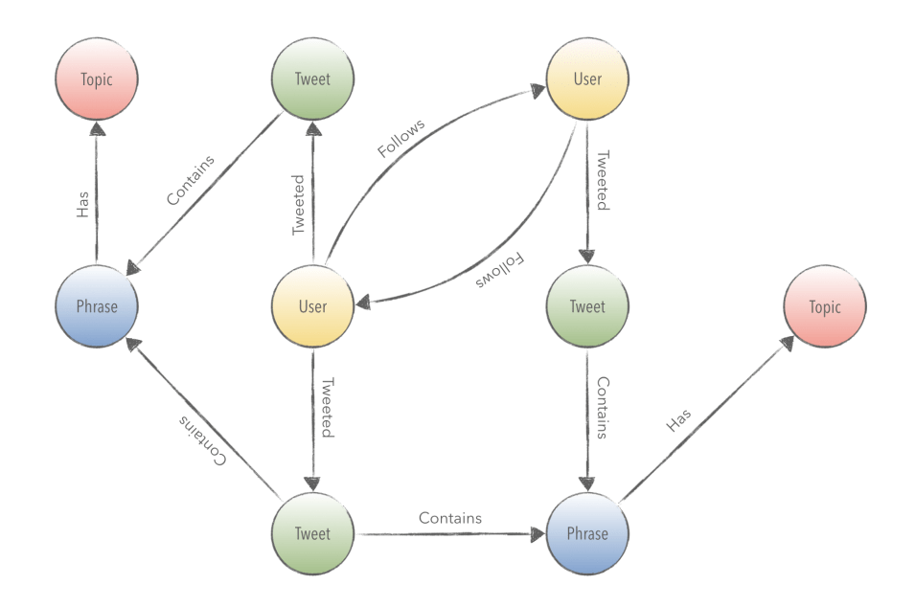
History of NoSQL Databases
2004- Google BigTable is launched

Slide 19
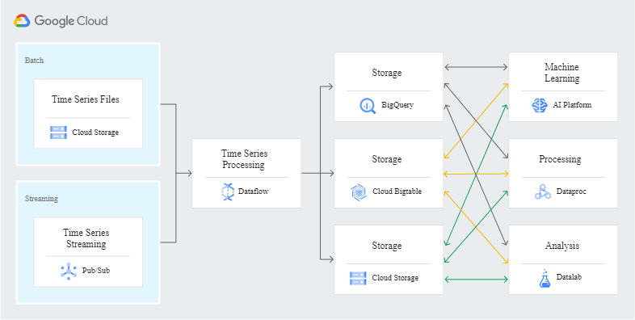
History of NoSQL Databases
2000- Graph database Neo4j is launched

Slide 20
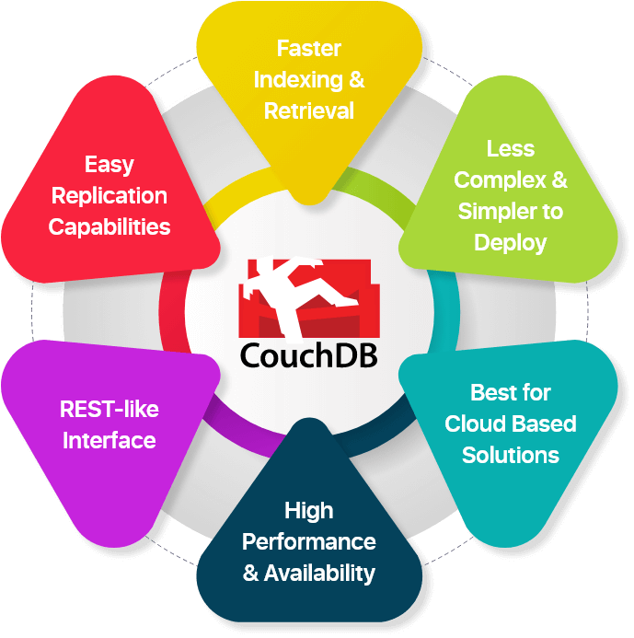
History of NoSQL Databases
2005- CouchDB is launched

Slide 21
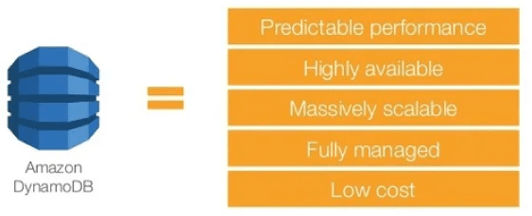
History of NoSQL Databases
2007- The research paper on Amazon Dynamo is released

Slide 22

History of NoSQL Databases
2008- Facebooks open sources the Cassandra project

Slide 23

History of NoSQL Databases
2009- The term NoSQL was reintroduced

Slide 24
Features of NoSQL
Non-relational
Schema-free
Simple API
Distributed

Slide 25
Features of NoSQL
Non-relational
  Never follow the relational model
  Never provide tables with flat fixed-column records
  Work with self-contained aggregates or BLOBs
  Doesn't require object-relational mapping and data normalization
  No complex features like query languages, query planners, referential integrity joins, ACID

Slide 26
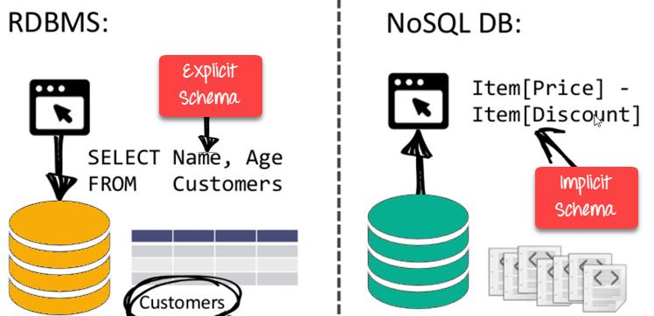
Features of NoSQL
Schema-free

Slide 27
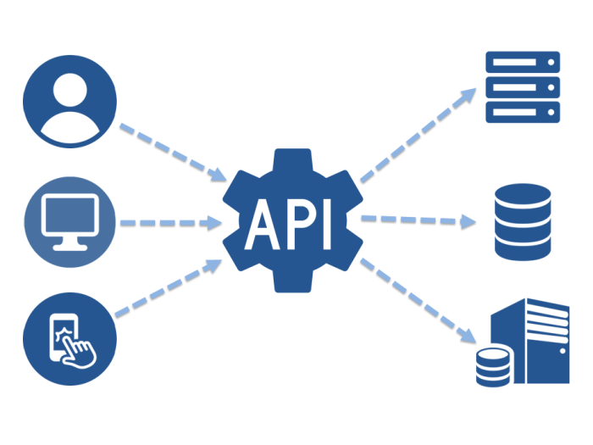
Features of NoSQL
Simple API

Slide 28
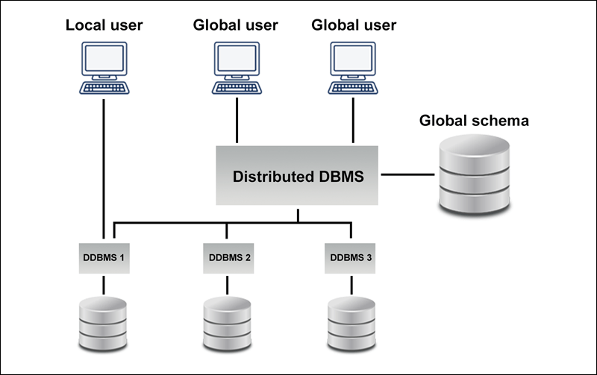
Features of NoSQL
Distributed

Slide 29
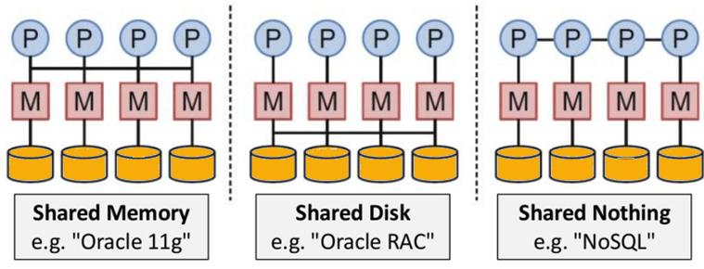
Features of NoSQL
Distributed
NoSQL is Shared Nothing.

Slide 30

Types of NoSQL Databases

Slide 31
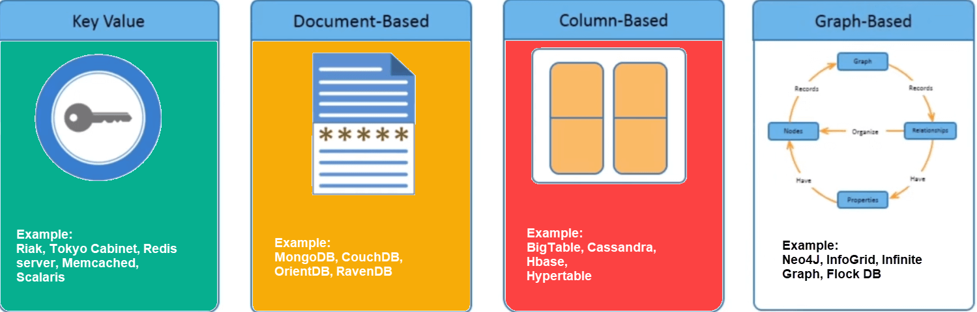
Types of NoSQL Databases

Slide 32
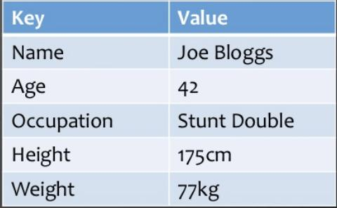
Key Value Pair Based

Slide 33
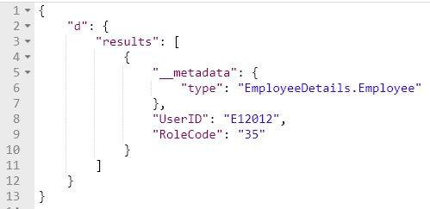
Key Value Pair Based
JSON

Slide 34

Key Value Pair Based
JSON
BLOB(Binary Large Objects)

Slide 35
Key Value Pair Based
NoSQL database is used as a collection, dictionaries, associative arrays, etc.
Key value stores help the developer to store schema-less data.
They work best for shopping cart contents.

Slide 36

Key Value Pair Based

Slide 37
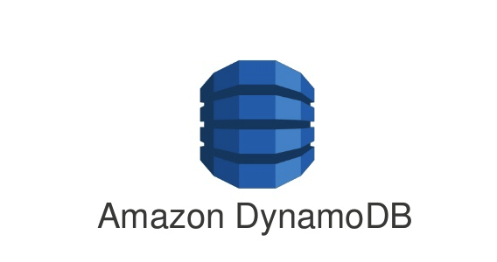
Key Value Pair Based

Slide 38

Key Value Pair Based

Slide 39
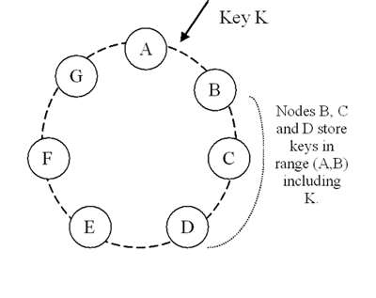
Key Value Pair Based
Based on Amazon's Dynamo paper.

Slide 40
COLUMN-BASED

Slide 41
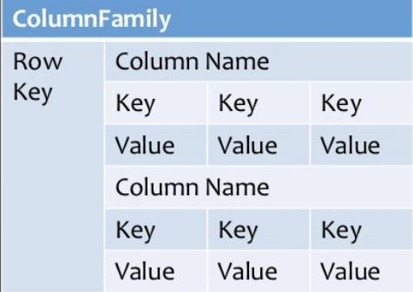
Column-based

Slide 42
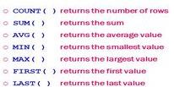
Column-based
They deliver high performance on aggregation queries

Slide 43
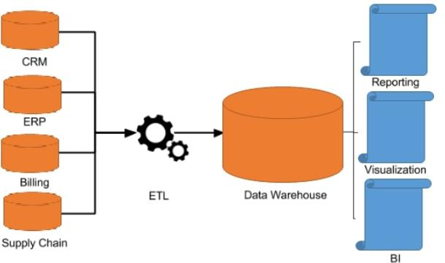
Column-based
Column-based NoSQL databases are widely used to manage
Dataware house

Slide 44

Column-based
Column-based NoSQL databases are widely used to manage

Slide 45
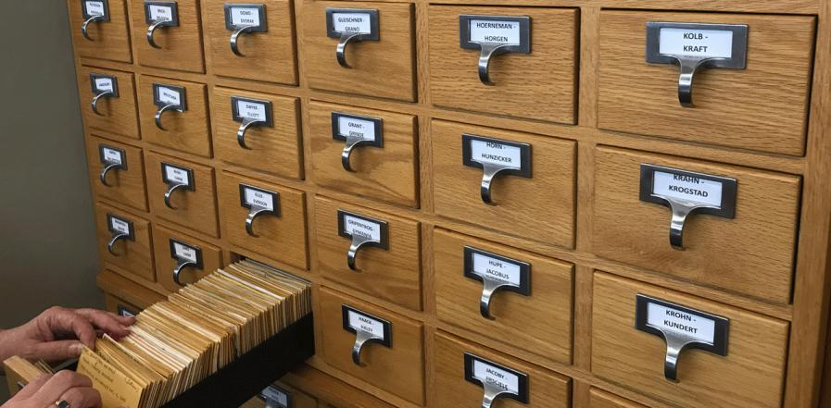
Column-based
Column-based NoSQL databases are widely used to manage
Library card catalogs

Slide 46
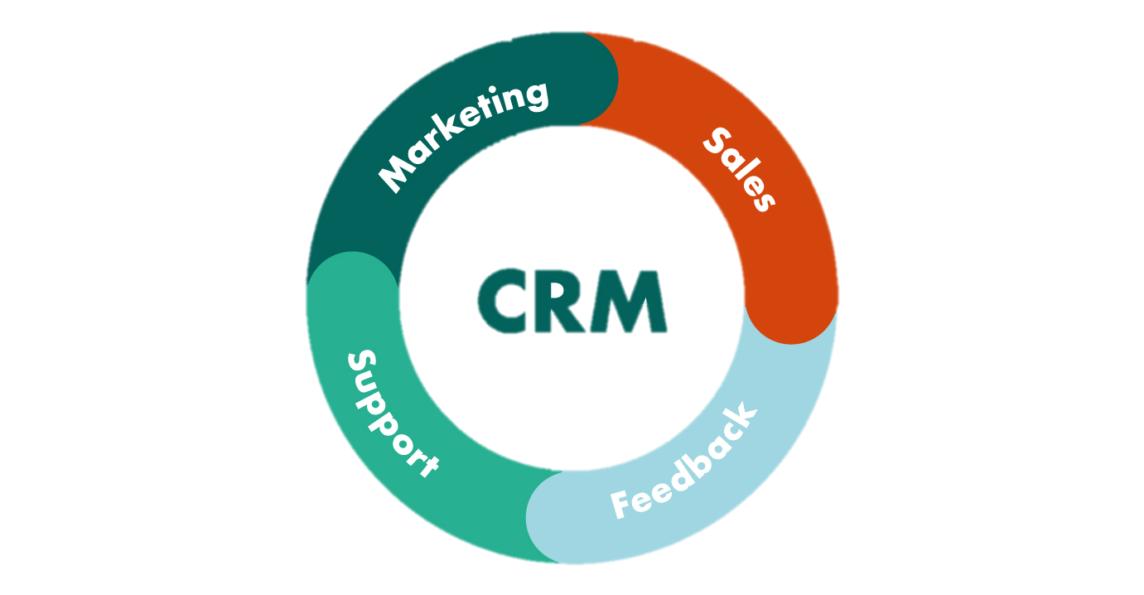
Column-based
Column-based NoSQL databases are widely used to manage

Slide 47

Column-based

Slide 48

Column-based

Slide 49

Column-based

Slide 50
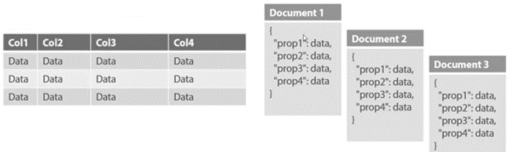
Document-Oriented

Slide 51
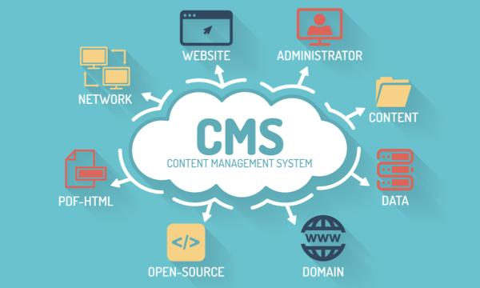
Document-Oriented
The document type is mostly used for

Slide 52

Document-Oriented
The document type is mostly used for

Slide 53

Document-Oriented
The document type is mostly used for

Slide 54

Document-Oriented
The document type is mostly used for

Slide 55

Document-Oriented
It should not use for complex transactions which require multiple operations or queries against varying aggregate structures.

Slide 56
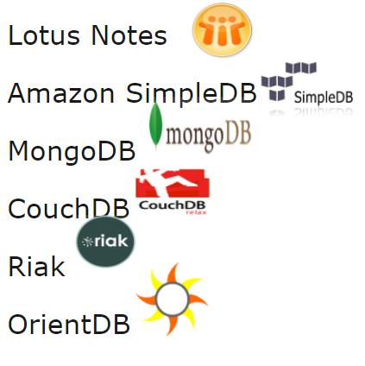
Document-Oriented
Popular Document originated DBMS systems

Slide 57
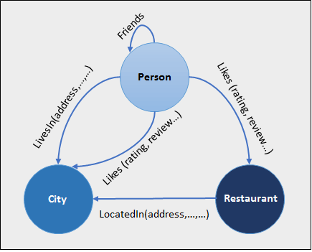
Graph-Based

Slide 58
Graph-Based
Graph base database mostly used for
  social networks,
  logistics,
  spatial data.

Slide 59
Graph-Based
Some popular graph-based databases.
  Neo4J,
  Infinite Graph,
  OrientDB,
  FlockDB

Slide 60
Query Mechanism tools for NoSQL
The most common data retrieval mechanism is the REST-based retrieval of a value based on its key/ID with GET resource
Document store Database offers more difficult queries as they understand the value in a key-value pair.
  For example, CouchDB allows defining views with MapReduce

